Slide 1

Applied Data Science Capstone
Shyanka Basak
25 March, 2023
1

Slide 2

Executive Summary
Introduction
Methodology
Results
Conclusion
Appendix
2

Slide 3





























































































•
•
•
•
•
•
•
•
3

Slide 4











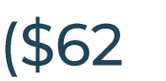

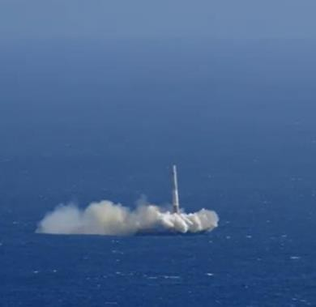




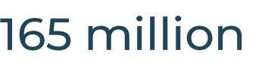











































•
•
•
•
•
4

Slide 5












5

Slide 6






































•
•
•
•
•
•
•
•
6

Slide 7





































































Data Collection Overview
7

Slide 8
Data Collection – SpaceXAPI
Applied-Data-Science-Capstone---IBM/Spacex data collection api.ipynb at main · shyanka21/Applied-Data-Science-Capstone---IBM (github.com)
Request (Space X APIs)
.JSON file + Lists(Launch Site, Booster Version, Payload Data)
Json_normalize to DataFrame data from JSON
Dictionary relevant data
Cast dictionary to a DataFrame
Filter data to only include Falcon 9 launches
Replace missing PayloadMass values with mean

Slide 9
Data Collection – WebScraping
Applied-Data-Science-Capstone---IBM/Spacex Webscraping.ipynb at main · shyanka21/Applied-Data-Science-Capstone---IBM (github.com)
Request Wikipedia html
BeautifulSoup html5lib Parser
Find launch info html table
Cast dictionary to DataFrame
Iterate through table cells to extract data to dictionary
Create dictionary

Slide 10








































Data Wrangling
https://github.com/shyanka21/Applied-Data-Science-Capstone---IBM/blob/main/Data%20wrangling.ipynb

Slide 11















































EDA with Data Visualization
https://github.com/shyanka21/Applied-Data-Science-Capstone---IBM/blob/main/EDA%20with%20python.ipynb

Slide 12































EDA with SQL
https://github.com/shyanka21/Applied-Data-Science-Capstone---IBM/blob/main/EDA%20with%20sql.ipynb

Slide 13


























Build an interactive map with Folium
https://github.com/shyanka21/Applied-Data-Science-Capstone---IBM/blob/main/Launch%20site%20location%20with%20folium.ipynb

Slide 14





Predictive analysis (Classification)
https://github.com/shyanka21/Applied-Data-Science-Capstone---IBM/blob/main/Machine%20Learning%20Prediction.ipynb

Slide 15

1
5

Slide 16

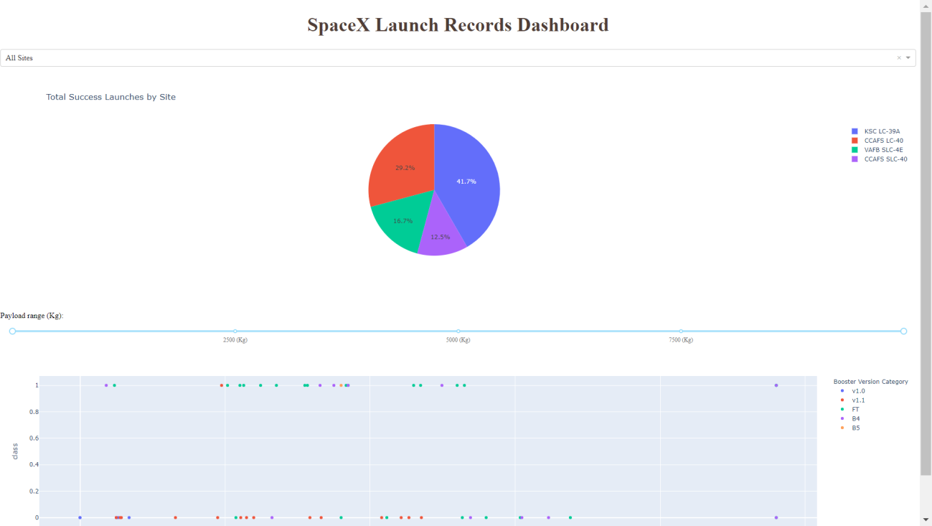
This is a preview of the Plotly dashboard. The following sides will show the results of EDA with visualization, EDA with SQL, Interactive Map with Folium, and finally the resultsof our model with about 83% accuracy.

Slide 17





WITH SEABORN PLOTS
EXPLORATORY
DATA ANALYSIS

Slide 18
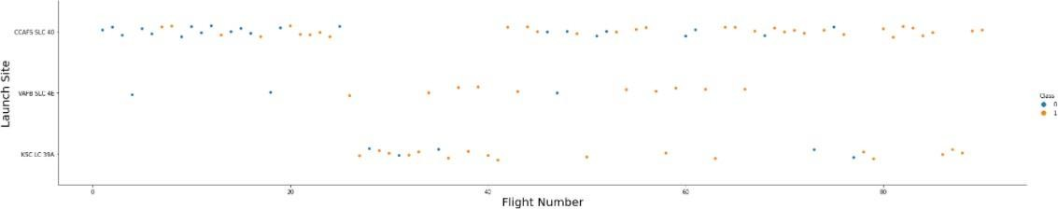
Flight Number vs. LaunchSite
Orange indicates successful launch; Blue indicates unsuccessful launch.
Graphic suggests an increase in success rate over time (indicated in Flight Number). Likely a big breakthrough around flight 20 which significantly increased success rate. CCAFS appears to be the main launch site as it has the most volume.

Slide 19
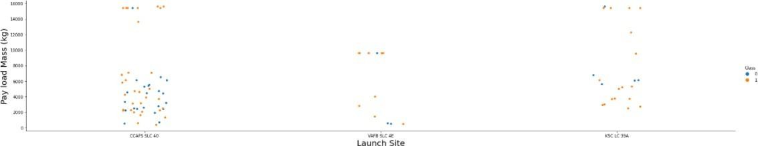
Payload vs. LaunchSite
Orange indicates successful launch; Blue indicates unsuccessful launch.
Payloadmass appears to fall mostly between 0-7000 kg. Different launch sites also seem to use different payload mass.

Slide 20
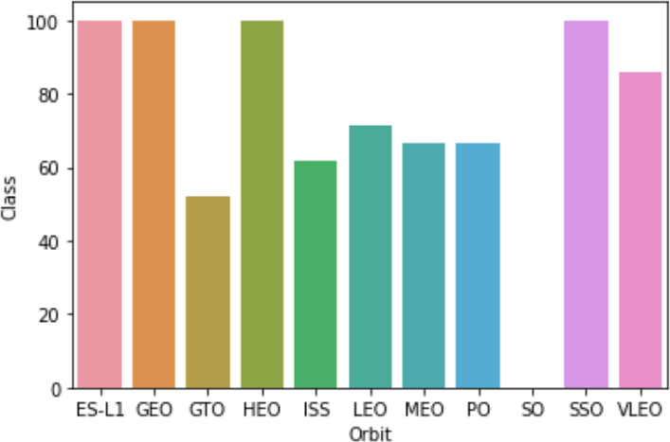
Successrate vs. Orbittype
Success Rate Scale with %
ES-L1 (1), GEO (1), HEO (1) have 100% success rate (sample sizes in parenthesis) SSO (5) has 100% success rate
VLEO (14) has decent success rate and attempts SO (1) has 0% success rate
GTO (27) has the around 50% success rate but largest sample
20

Slide 21
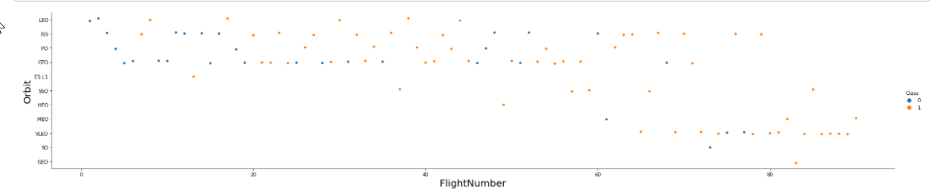
Flight Number vs. Orbittype
Orange indicates successful launch; Purple indicates unsuccessful launch.
Launch Orbit preferences changed over Flight Number. Launch Outcome seems to correlatewith this preference.
SpaceX started with LEO orbits which saw moderate success LEO and returned to VLEO in recent launches
SpaceX appears to perform better in lower orbits or Sun-synchronous orbits

Slide 22
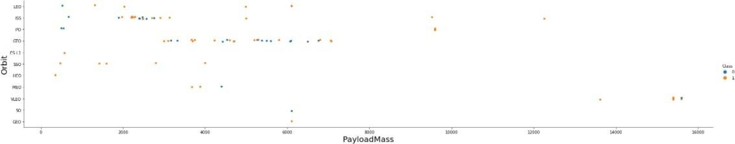
Payload vs. Orbit type
Orange indicates successful launch; Purple indicates unsuccessful launch.
Payload mass seems to correlatewith orbit
LEO and SSO seem to have relatively low payload mass
The other most successful orbit VLEO only has payload mass values in the higher end of the range

Slide 23
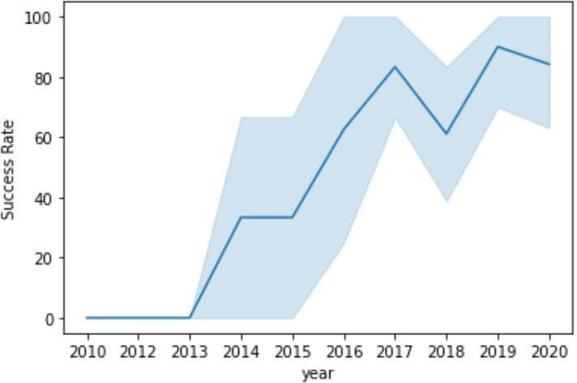
Launch SuccessYearlyTrend
95% confidence interval (light blue shading)
Success generally increases over time since 2013 with a slight dip in 2018 Success in recent years at around 80%

Slide 24






EXPLORATORY DATA ANALYSIS WITH SQL DB2 INTEGRATED IN PYTHON WITH SQLALCHEMY

Slide 25
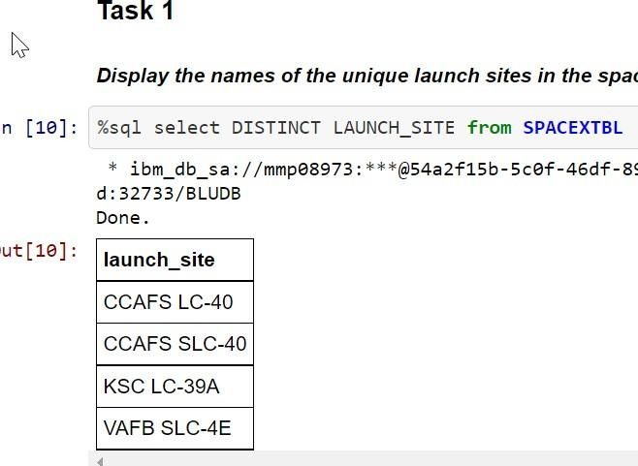
All Launch SiteNames
◆ Query unique launch site names from database.
◆ CCAFS SLC-40 and CCAFSSLC-40 likely all represent the same
◆ launch site with data entry errors.
◆ CCAFS LC-40 was
the previous name. Likely only
3 unique launch_site
25
values: CCAFS

Slide 26
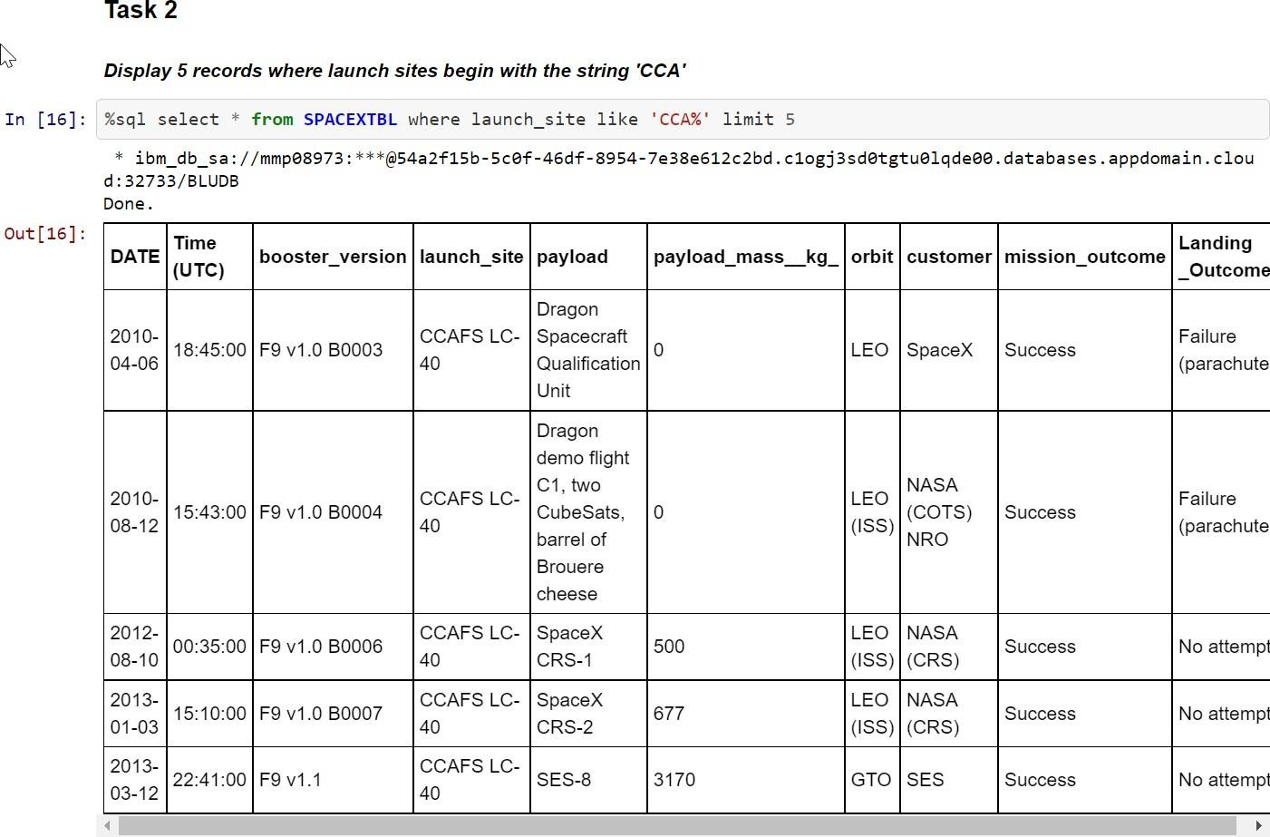
Launch Site NamesBeginning with `CCA`
First five entries in databasewith Launch Site name beginning with CCA.

Slide 27
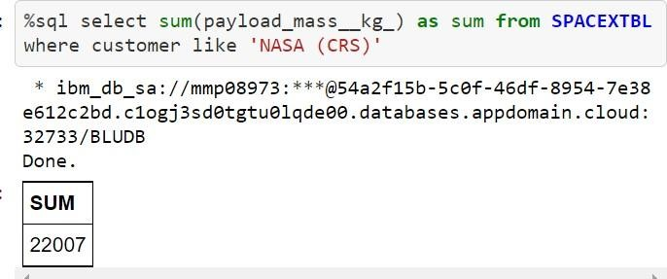
Total Payload Mass from NASA
This query sums the totalpayload mass in kg where NASA was the customer.
CRS stands for Commercial Resupply Services which indicates that these payloads were sent to the International Space Station (ISS).

Slide 28
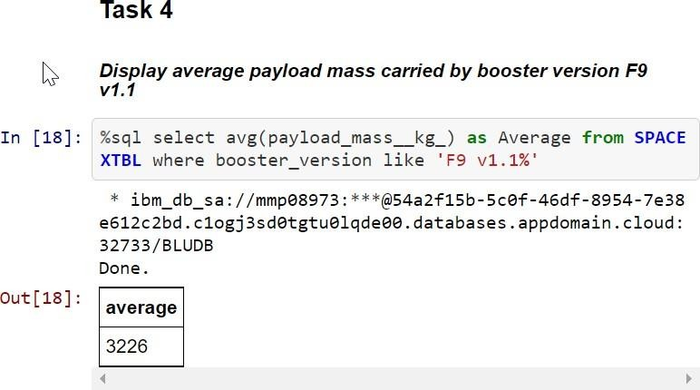
Average Payload Mass by F9v1.1
This query calculates the average payload mass or launches which used booster version F9 v1.1
Average payload mass of F9 1.1 is on the low endof our payload mass range

Slide 29
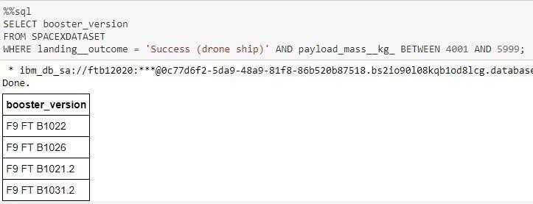
SuccessfulDrone Ship Landing with Payload
Between 4000 and6000
This query returns the four booster versions that had successful drone ship landings and a payload mass between 4000 and 6000 noninclusively.

Slide 30
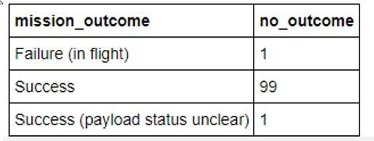
Total Number of EachMissionOutcome
This query returns a count ofeach
mission outcome.
SpaceX appears to achieve its mission outcome nearly 99% of the time.
This means that most of the landing
failures are intended.
Interestingly, one launch has an unclear payload status and unfortunately one failed in flight.

Slide 31
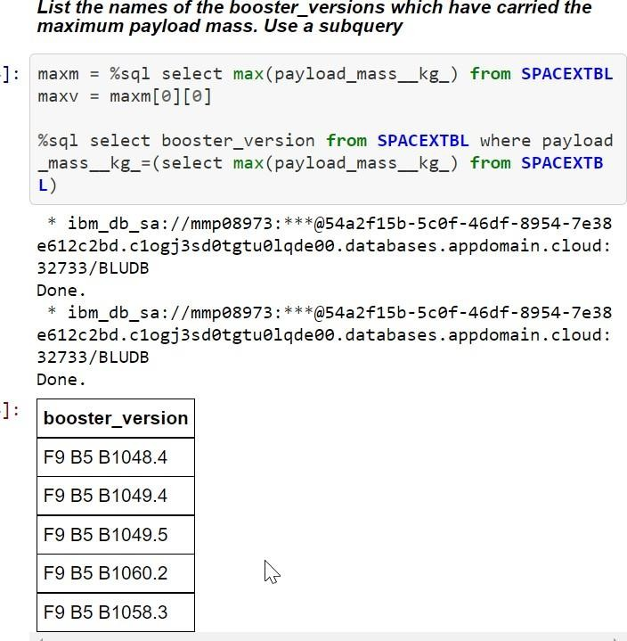
Boosters that Carried MaximumPayload
This query returns the booster versions that carried the highest payload mass of 15600 kg.
These booster versions are very similar and all are of the F9 B5 B10xx.xvariety.
This likely indicates payload mass correlates with the booster versionthat is used.

Slide 32





Slide 33

Launch Site Locations
The left map shows all launch sites relative US map. The right map shows the two Florida launch sites since they are very close to each other. All launch sites are near the ocean.

Slide 34

Color-Coded Launch Markers
Clusters on Folium map can be clicked on to display each successful landing (green icon) and failed landing (red icon). In this example VAFB SLC-4E shows 4 successful landings and 6 failed landings.

Slide 35


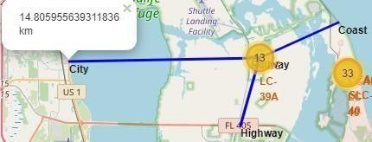
Key Location Proximities
Using KSC LC-39A as an example, launch sites are very close to railways for large part and supply transportation. Launch sites are close to highways for human and supply transport. Launch sites are also close to coasts and relatively far from cities so that launch failures can land in the sea to avoid rockets falling on densely populated areas.

Slide 36
Build a Dashboard with Plotly Dash

Slide 37
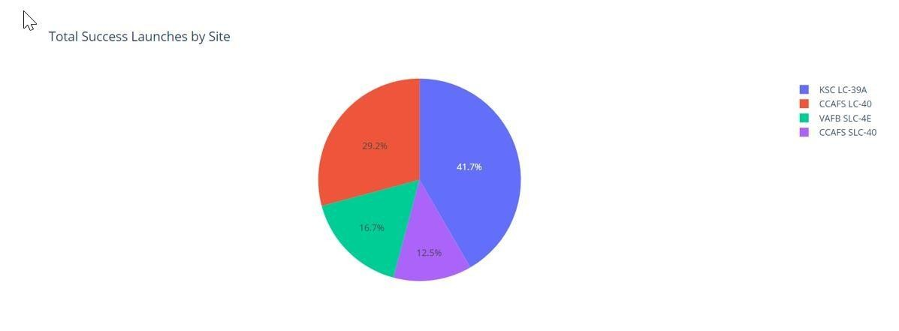

Successful LaunchesAcross Launch Sites
This is the distribution of successful landings across all launch sites. CCAFS LC-40 is the old name of CCAFS SLC-40 so CCAFS and KSC have the same amount of successful landings, but a majority of the successful landings where performed before the name change. VAFB has the smallest share of successful landings. This may be due to smaller sample and increase in difficulty of launching in the westcoast.

Slide 38

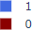
Highest Success Rate Launch Site
KSC LC-39A has the highest success rate with 10 successful landings and 3 failed landings.

Slide 39
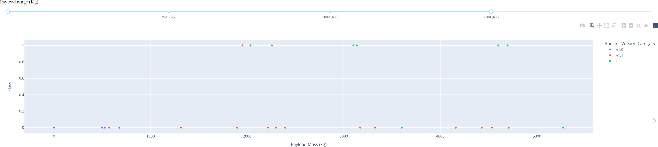
Payload Mass vs. Successvs. Booster Version Category
Plotly dashboard has a Payload range selector. However, this is set from 0-10000 instead of the max Payload of 15600. Class indicates 1 for successful landing and 0 for failure. Scatter plot also accounts for booster version category in color and number of launches in point size. In this particular range of 0-7500, interestinglythere are two failed landings with payloads of zero kg.

Slide 40



GRIDSEARCHCV(CV=10) ON LOGISTIC REGRESSION,SVM, DECISION
TREE, AND KNN

Slide 41
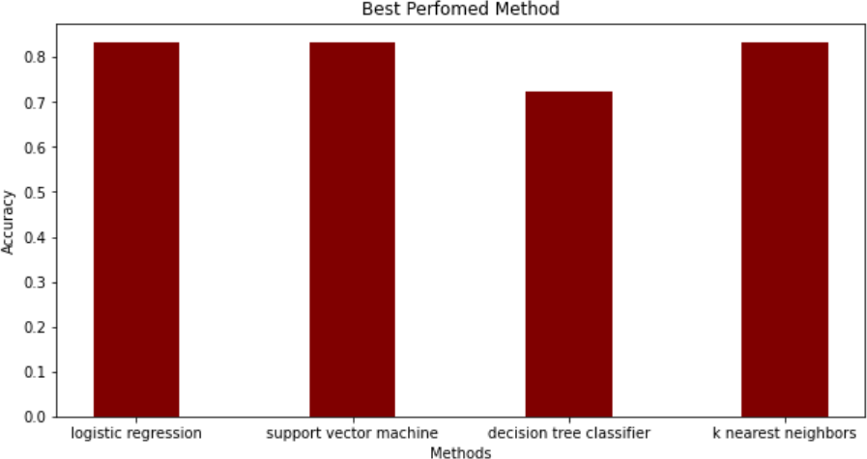
ClassificationAccuracy
The models had virtually the same accuracy on the test set at 83.33%accuracy, except the decision tree classifier with 72,23 %.
It should be noted that test size is small at only sample size of 18.
This can cause large variance in accuracy results, such as those in Decision Tree Classifier model in repeated runs.
We likely need more data to determine the best model.

Slide 42

Confusion Matrix
Correct predictions are on a diagonal from top left to bottomright.
Since all models performed the same for the test set, the confusion matrix is the same across all models.
The models predicted 12 successful landings when the true label was successful landing.
The models predicted 3 unsuccessful landings when the true label was unsuccessful landing.
The models predicted 3 successful landings when the true label was unsuccessful landings (false positives).
42
Our models over predict successful landings.

Slide 43
CONCLUSION
Our task: to develop a machine learning model for Space Y who wants to bid against SpaceX
The goal of model is to predict when Stage 1 will successfully land to save ~$100 million USD
Used data from a public SpaceX API and web scraping SpaceX Wikipedia page
Createddatalabels and storeddata intoa DB2 SQL database
Created a dashboard for visualization
We createda machine learning model with an accuracy of 83%
Allon Mask of SpaceY can use this model to predict with relatively high accuracy whether a launch will have a successful Stage 1 landing beforelaunch to determine whether the launch should be made or not
More data should be collected to better determine the best machine learning model and
improvethe accuracy

Slide 44
APPENDIX
GitHub repository url:
shyanka21/Applied-Data-Science-Capstone---IBM (github.com)
Special Thanks to All Instructors
SpaceX data Wikipedia

